Slide 1
Time Series Forecasting
Dong Zhang (dongzhang@slack)

Slide 2
TIME SERIES Forecasting
What is time series?
Demo: 1. Exponential Smoothing Model 2. ARIMA/SARIMA 3. Facebook Prophet 4. Long Short-Term Memory (LSTM)

Slide 3
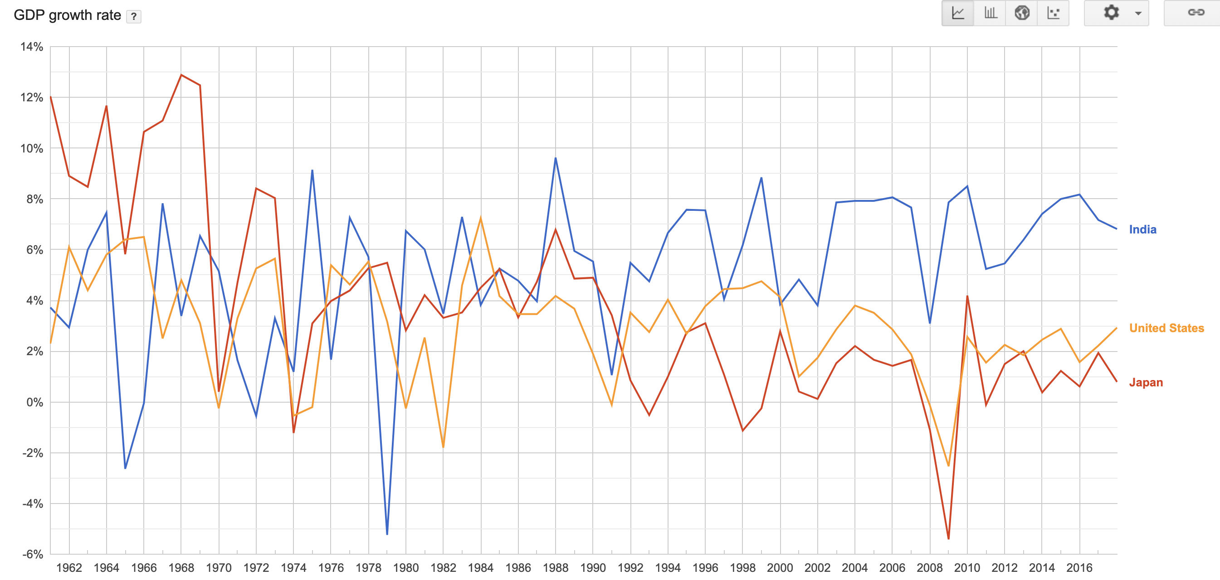
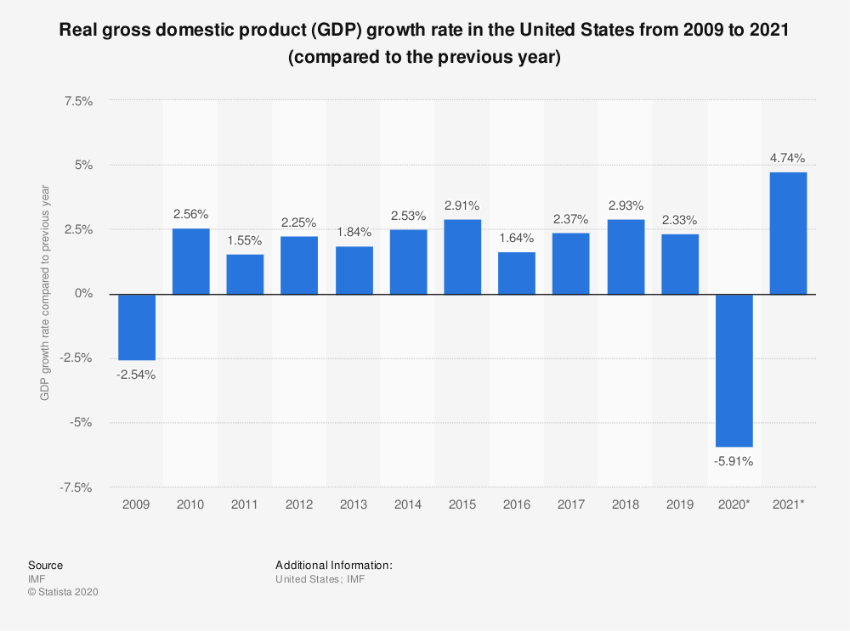
What is Time Series
A time series is a sequence of information that attaches a time period to each value.

Slide 4
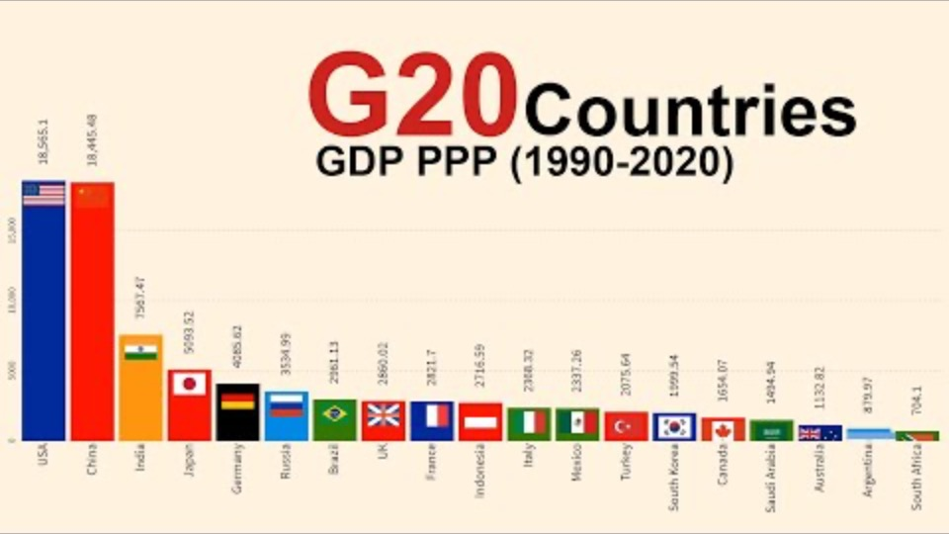
What is Time Series
A time series is a sequence of information that attaches a time period to each value.

Slide 5
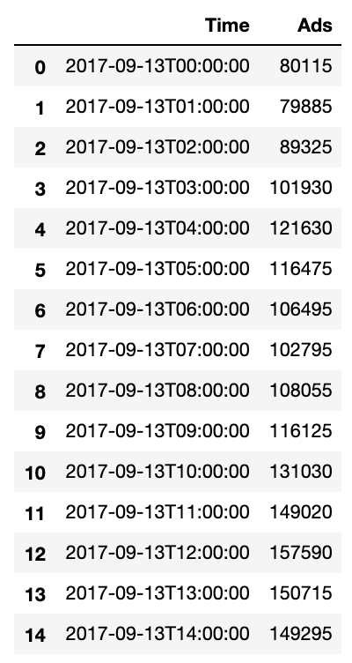
CASE STUDY: Hourly Ads

Slide 6

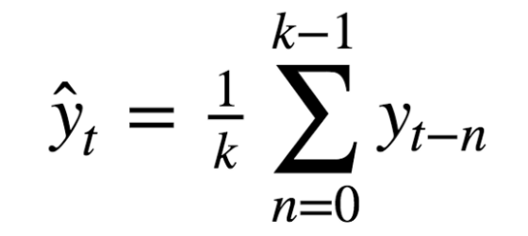
Smooth Time SERIES
moving average (MA)
Credit: https://medium.com/open-machine-learning-course/open-machine-learning-course-topic-9-time-series-analysis-in-python-a270cb05e0b3

Slide 7
Smooth Time SERIES
moving average (MA)
k = 4

Slide 8
Smooth Time SERIES
moving average (MA)
k = 12

Slide 9
Smooth Time SERIES
moving average (MA)
k = 24

Slide 10

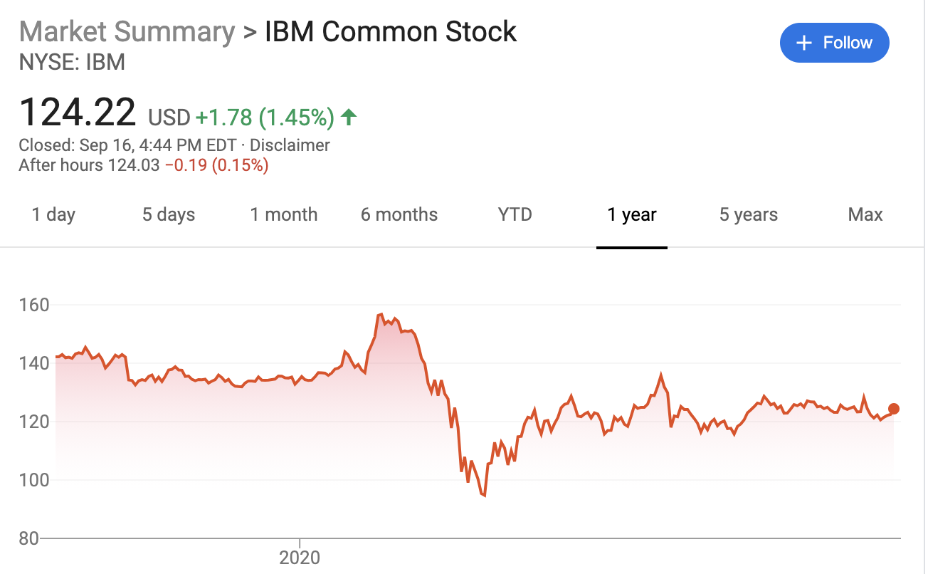
TIME SERIES Forecasting
How to use the past data to predict the future?

Slide 11
TIME SERIES Forecasting
Linear Regression?

Slide 12
TIME SERIES Forecasting
Exponential Smoothing Model
ARIMA/SARIMA Family
Facebook Prophet
Long Short-Term Memory (LSTM)

Slide 13
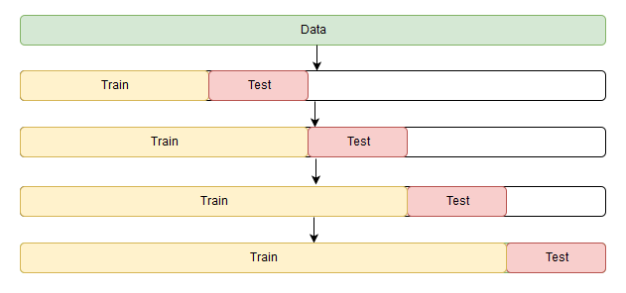
Forecasting Cross Validation

Slide 14
Forecasting Cross Validation

Slide 15
Forecasting Cross Validation

Slide 16
Forecasting Cross Validation

Slide 17
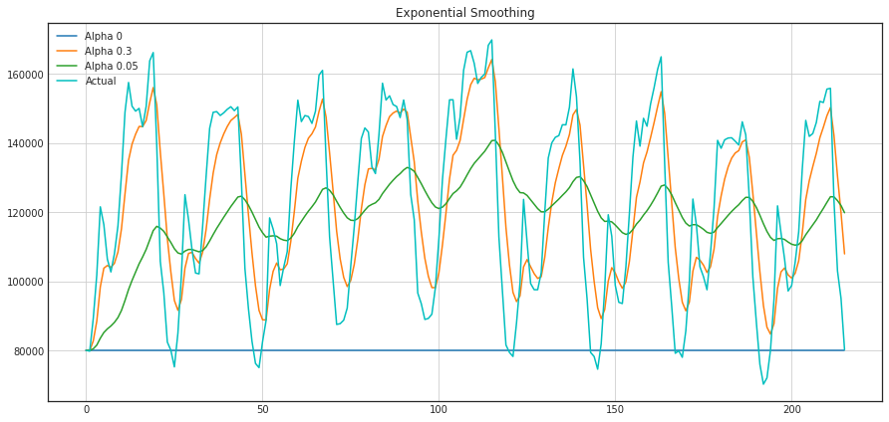
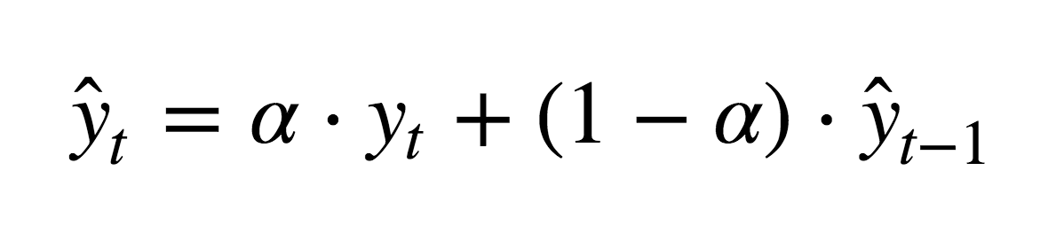
Exponential Smoothing
The time series forecasting y on time t
depends on the data at t
and the old forecasting at t-1
Real data: y₀, y₁, y₂, y₃, y₄, ….
Prediction: y₀, y₁, y₂, y₃, y₄, ….
α = 0 → initial data point
α = 1 → actual data

Slide 18
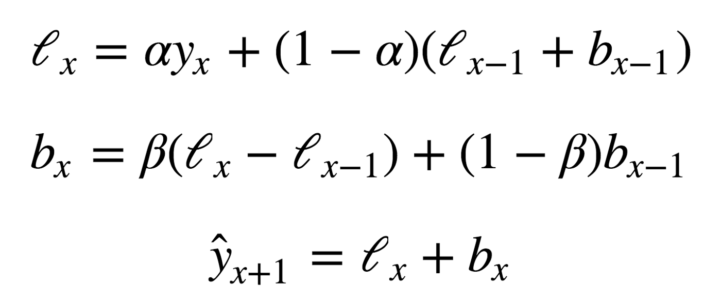
Double Exponential Smoothing
parameters: α, β

Slide 19
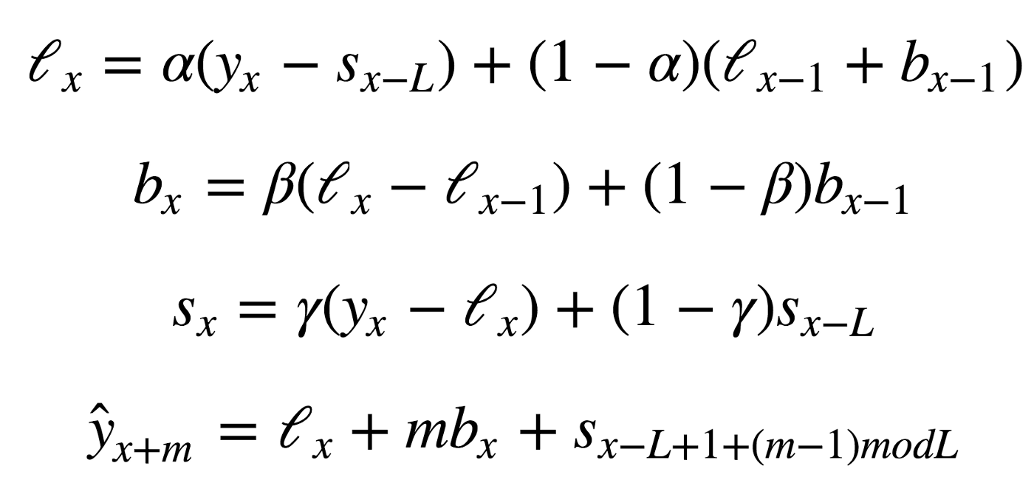
TRIPLE Exponential Smoothing
?
parameters:
α, β, γ

Slide 20
exponential Smoothing FORECASTING
α = 0.11652680227350454
β = 0.002677697431105852
γ = 0.05820973606789237

Slide 21
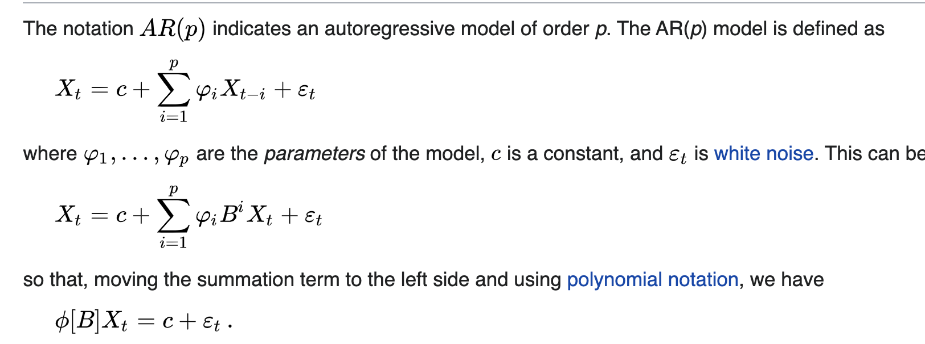
ARIMA/SARIMA Family
Auto-Regressive (AR) --> p
a linear combination of past values of the variable
A lot of math! …

Slide 22
ARIMA/SARIMA Family
Auto-Regressive (AR) --> p
a linear combination of past values of the variable
A lot of math! …

Slide 23
ARIMA/SARIMA Family
Auto-Regressive (AR) --> p
Moving Average (MA) --> q
Auto-Regressive Moving Average (ARMA) --> p, q
Auto-Regressive Integrated Moving Average (ARIMA) --> p, q, d
Seasonal Auto-regression Moving Average model (SARIMA) --> (p,d,q)(P,D,Q,s)
a linear combination of past values of the variable
a linear combination of past forecast errors

Slide 24
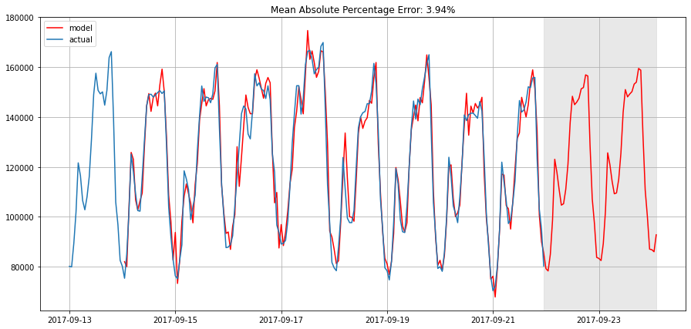
SARIMA: Parameter Scanning
from statsmodels.tsa.arima_model import SARIMA
(SARIMA) --> (p,d,q)(P,D,Q,s)
# setting initial values and some bounds for them
p = range(2, 5)
d=1
q = range(2, 5)
P = range(0, 3)
D=1
Q = range(0, 2)
s = 24
# creating list with all the possible combinations of parameters
parameters = product(p, q, P, Q)

Slide 25
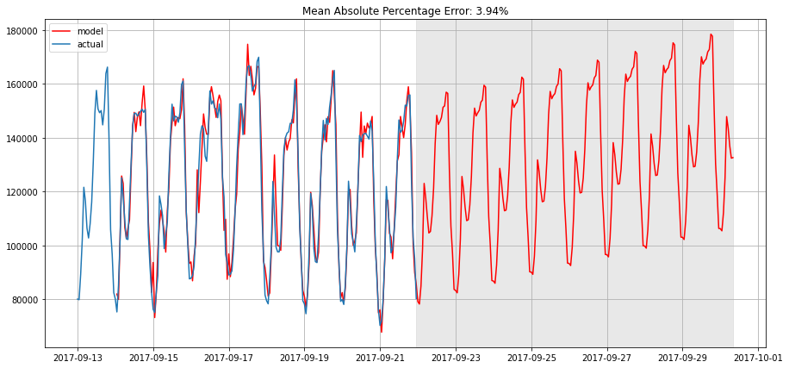
SARIMA: Parameter Scanning
from statsmodels.tsa.arima_model import SARIMA
(SARIMA) --> (p,d,q)(P,D,Q,s)
# setting initial values and some bounds for them
p = range(2, 5)
d=1
q = range(2, 5)
P = range(0, 3)
D=1
Q = range(0, 2)
s = 24
# creating list with all the possible combinations of parameters
parameters = product(p, q, P, Q)

Slide 26
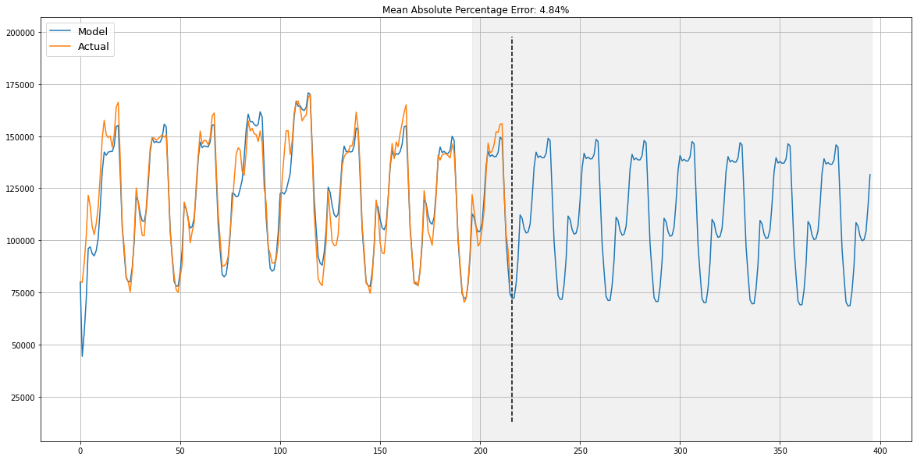
SARIMA vs. Exponential Smoothing
(p,d,q)(P,D,Q,s)
α, β, γ

Slide 27

Prophet (Facebook TOOL) Quick Start
https://facebook.github.io/prophet/docs/quick_start.html

Slide 28
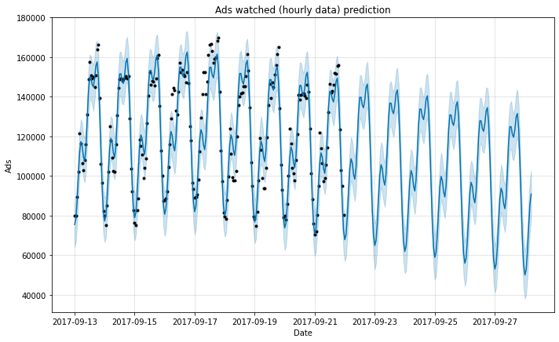
Prophet
from fbprophet import Prophet
ads_model = Prophet()
ads_model.fit(ads)
ads_forecast = ads_model.make_future_dataframe(periods=100, freq='H’)
ads_forecast = ads_model.predict(ads_forecast)

Slide 29
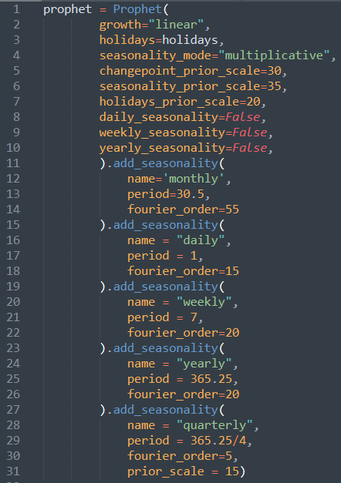
Prophet Hyper Parameters
In general, no parameters, it is curve fitting
Seasonality
Change Prior Scale (flexibility)
https://towardsdatascience.com/implementing-facebook-prophet-efficiently-c241305405a3

Slide 30
SARIMA vs Prophet
SARIMA Family: Trends, past-future
Best Curve Fitting

Slide 31
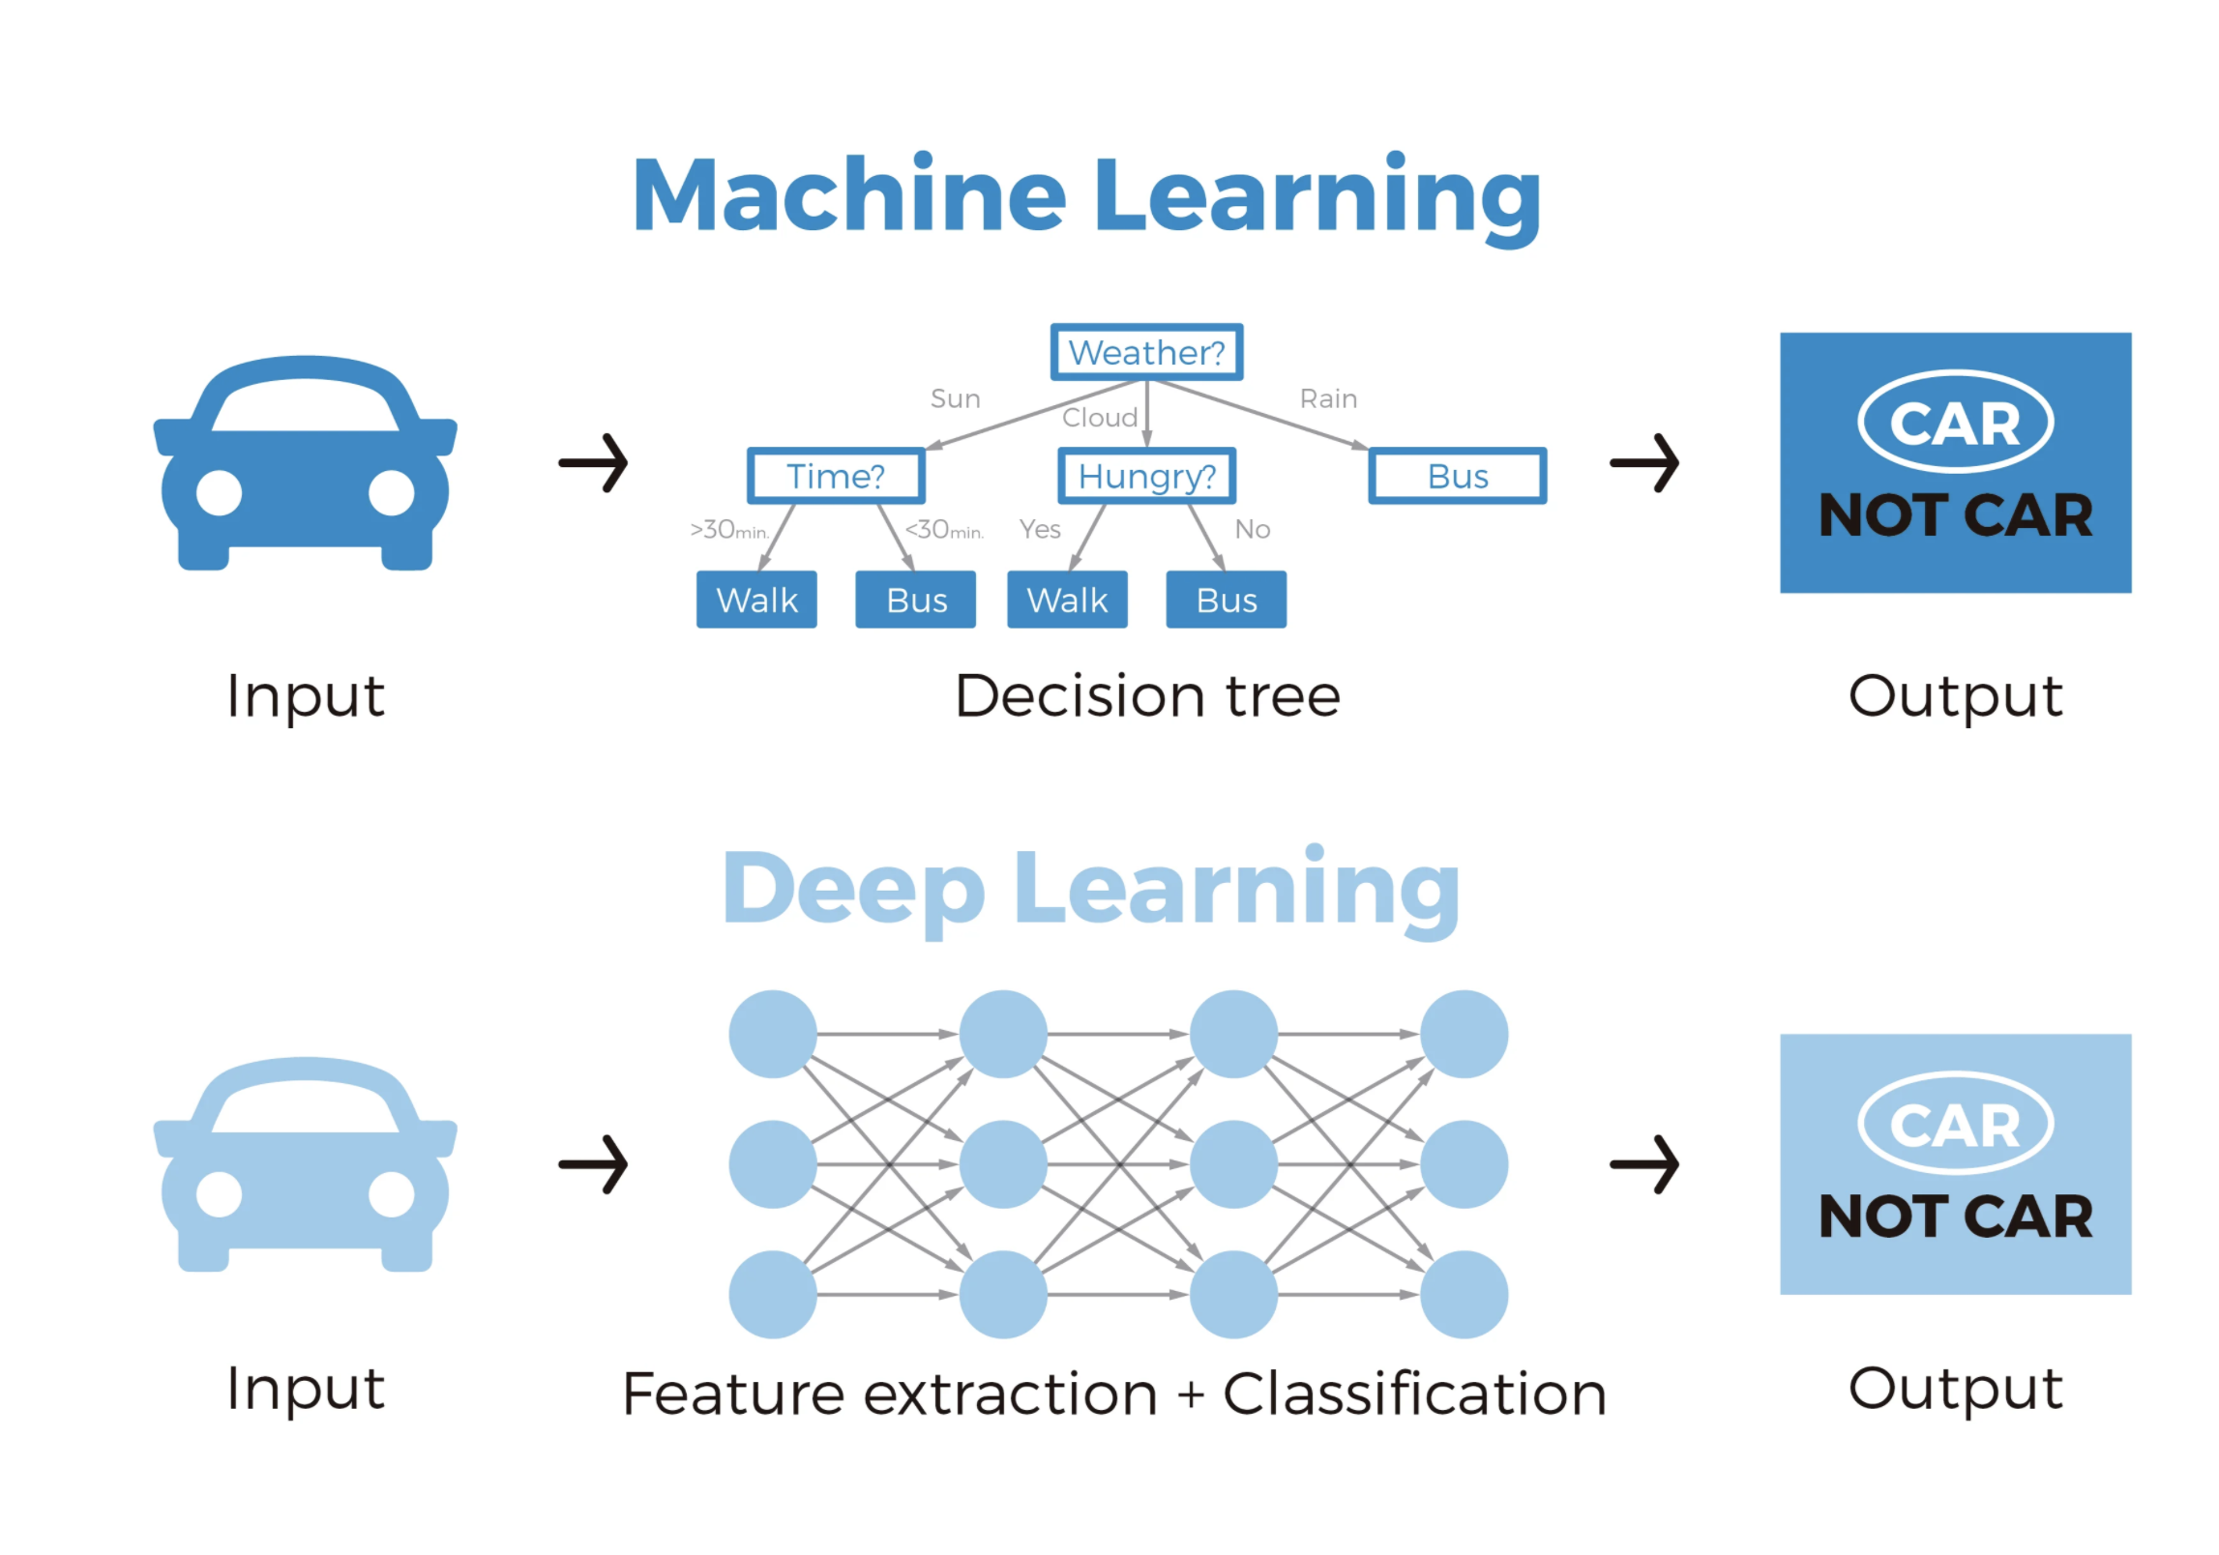
Deep Learning: Neural Network

Slide 32
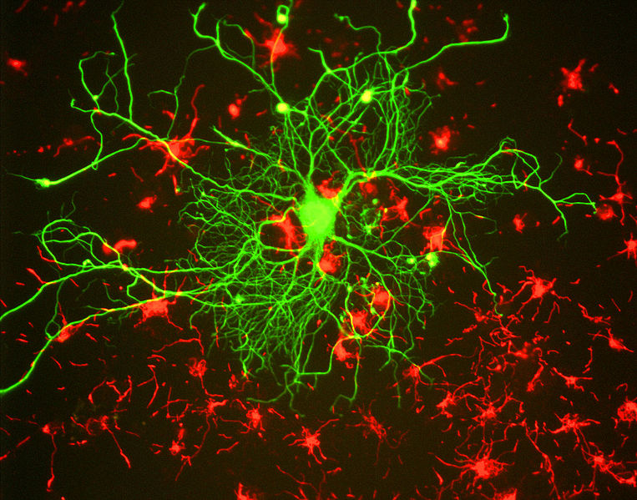

Deep Learning: Neural Network

Slide 33
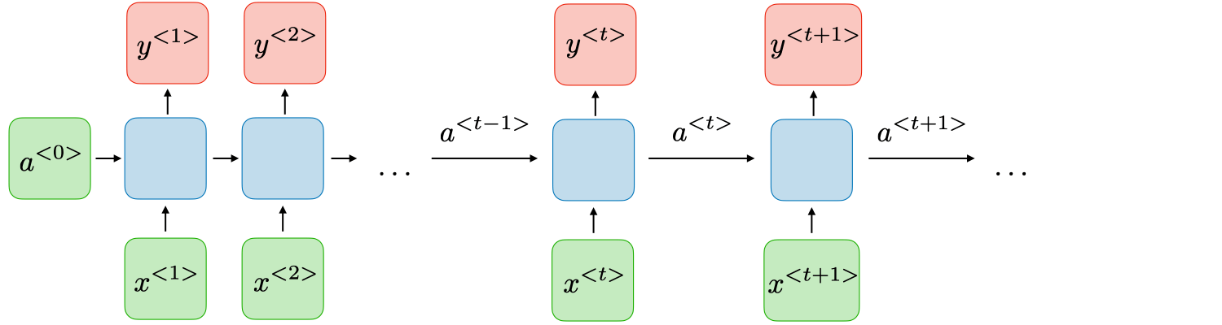
Deep Learning: Neural Network
Artificial Neural Network (ANN)
Recurrent Neural Network (RNN)

Slide 34
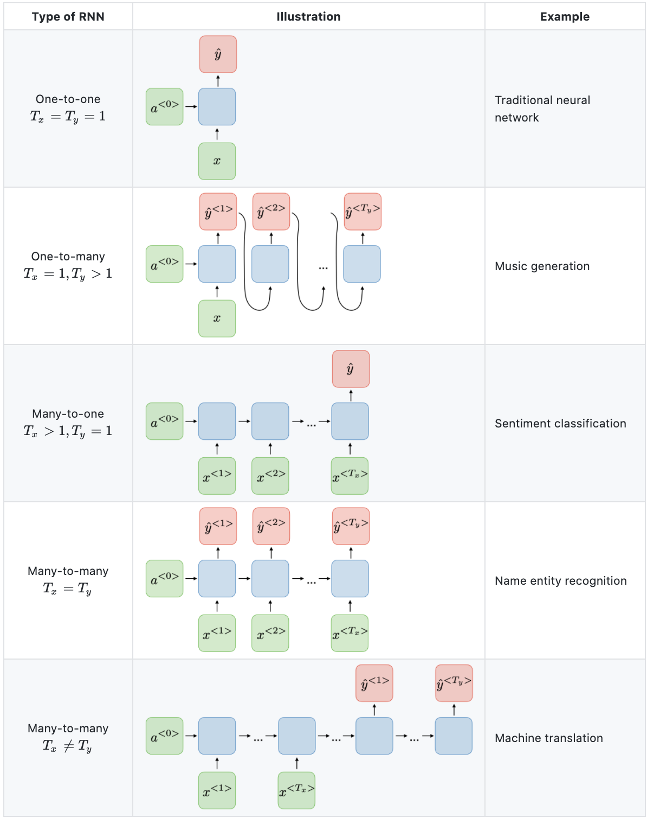
Recurrent Neural Network
https://stanford.edu/~shervine/teaching/cs-230/cheatsheet-recurrent-neural-networks

Slide 35
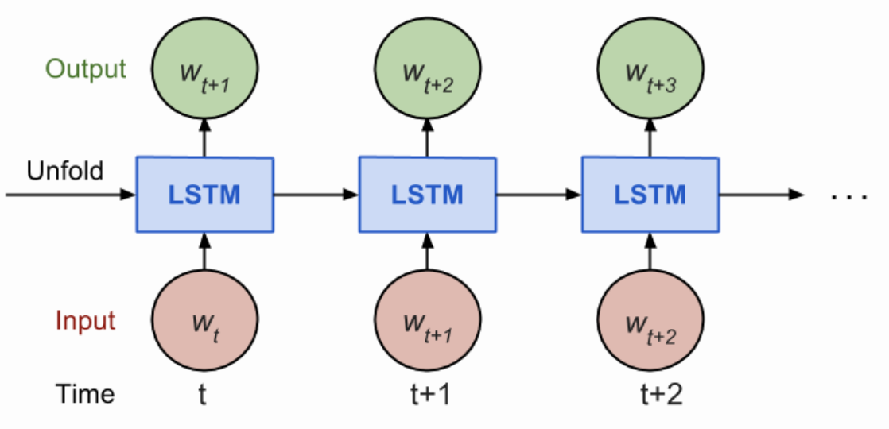
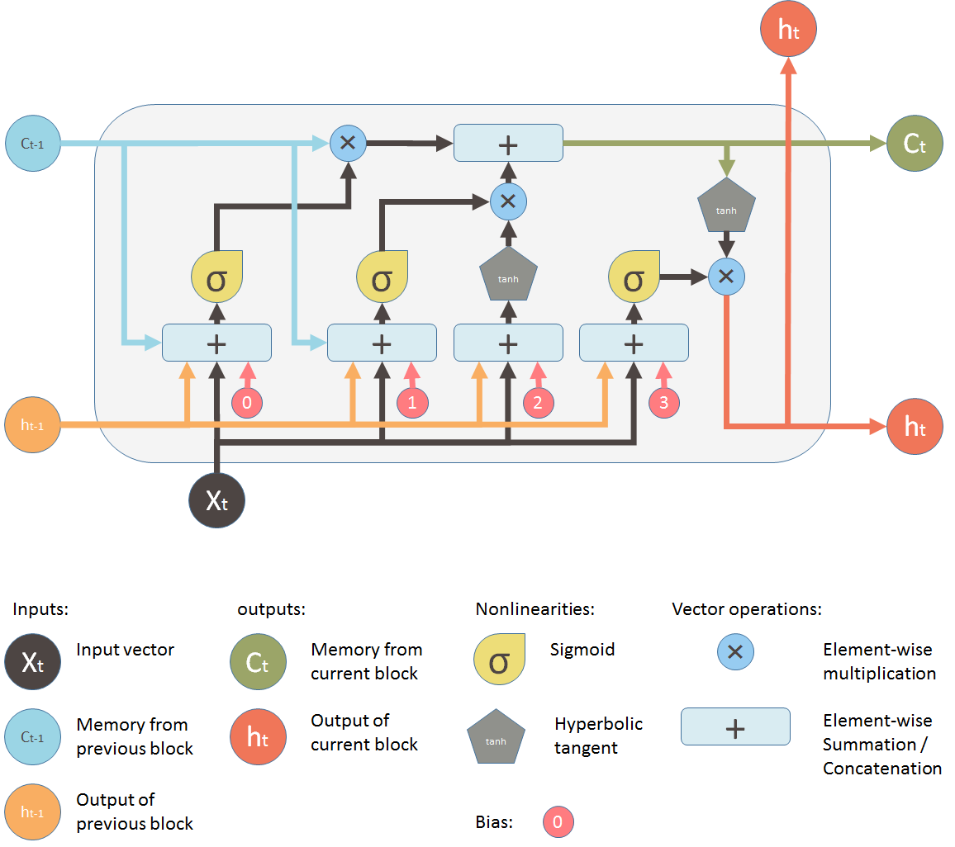
Long-Short Term Memory (LSTM)
https://stanford.edu/~shervine/teaching/cs-230/cheatsheet-recurrent-neural-networks

Slide 36

Time Series Forecasting using LSTM

Slide 37
Time Series Forecasting using LSTM
One LSTM LAYER
import tensorflow as tf
model = tf.keras.Sequential()
model.add(LSTM(200, activation='relu', input_shape=(n_input, n_features)))
model.add(Dropout(0.15))
model.add(Dense(1))
model.compile(optimizer='adam', loss='mse')
model.fit_generator(generator,epochs=90)
Multiple LSTM LAYER
model = tf.keras.Sequential()
model.add(LSTM(200, activation='relu', return_sequences = True, input_shape=(n_input, n_features)))
model.add(Dropout(0.15))
# Adding a second LSTM layer and some Dropout regularisation
model.add(LSTM(100, return_sequences = True, activation='relu'))
model.add(Dropout(0.15))
# Adding a third LSTM layer and some Dropout regularisation
model.add(LSTM(50, return_sequences = True, activation='relu'))
model.add(Dropout(0.2))
# Adding a fourth LSTM layer and some Dropout regularisation
model.add(LSTM(50))
model.add(Dropout(0.2))
#Adding the output layer
model.add(Dense(1))
model.compile(optimizer='adam', loss='mse')

Slide 38
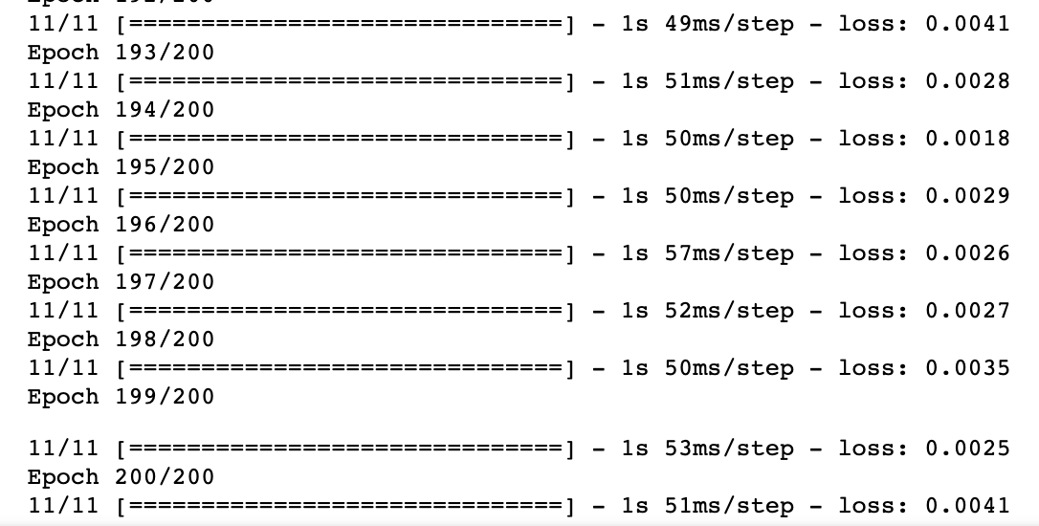
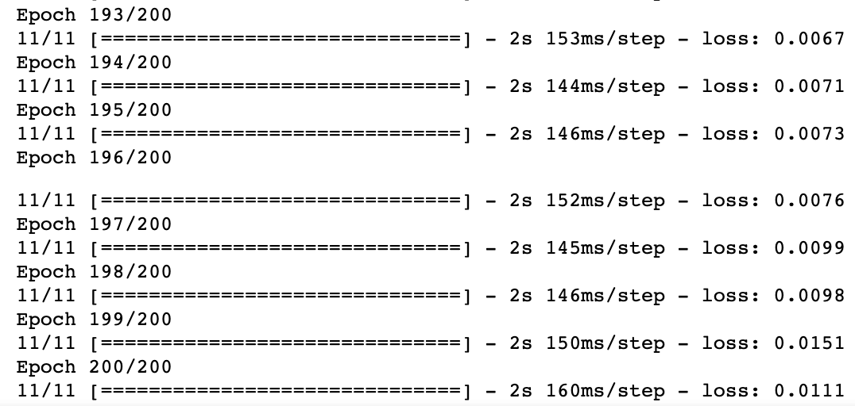
Time Series Forecasting using LSTM
One LSTM LAYER
Multiple LSTM LAYER

Slide 39
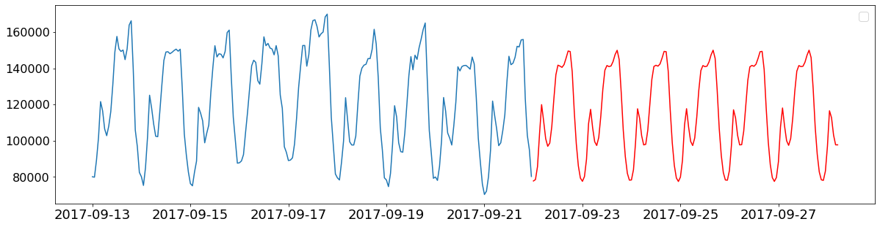
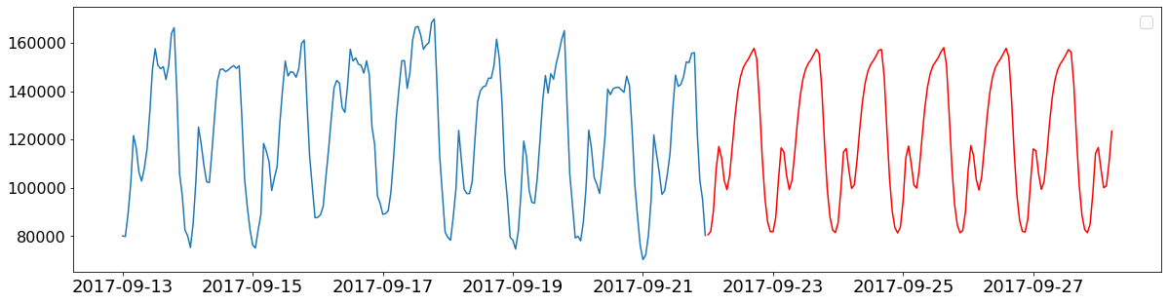
Time Series Forecasting using LSTM
One LSTM LAYER
Multiple LSTM LAYER

Slide 40
Summary
Prophet: always a nice first try (no parameter)
Exponential Smoothing (three parameters)
ARIMA/SARIMA Family: parameter search (7 parameters)
Deep Learning (LSTM): very large dataset (many parameters)

Slide 41
Summary

Slide 42
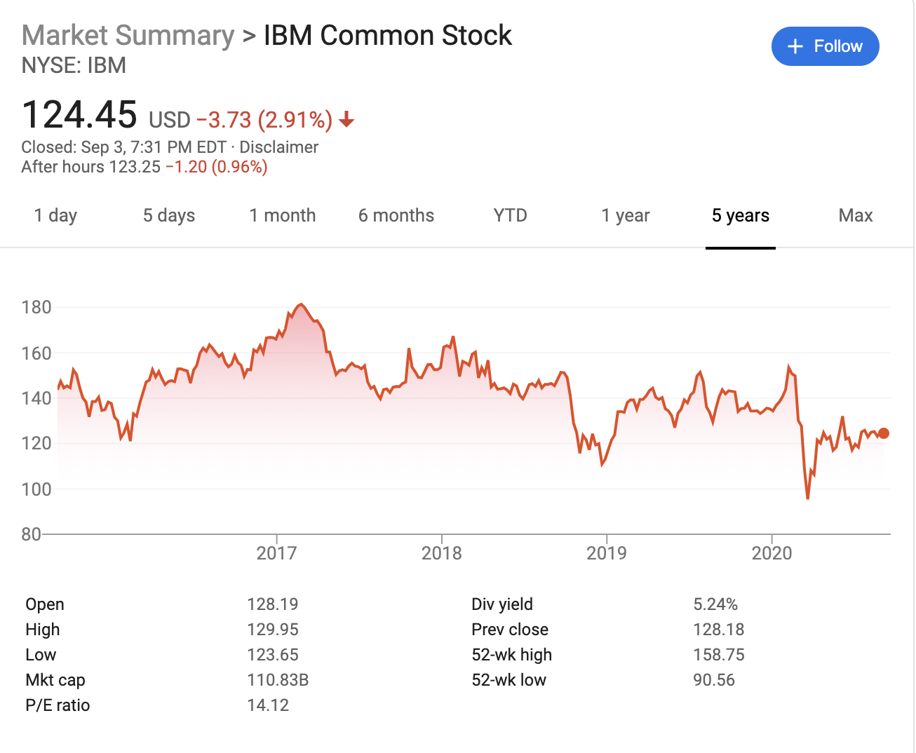
STOCKS?
Data download from:
https://www.macrotrends.net/stocks/charts/IBM/ibm/stock-price-history

Slide 43
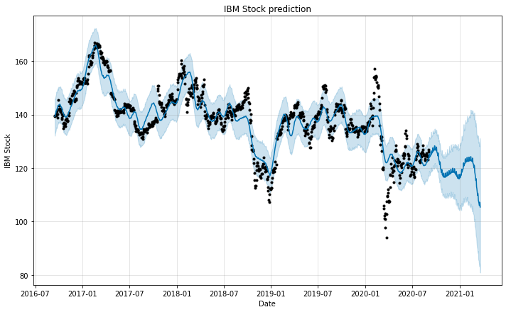
IBM STOCKS : Prophet
Prophet: 1000 day --> prediction

Slide 44
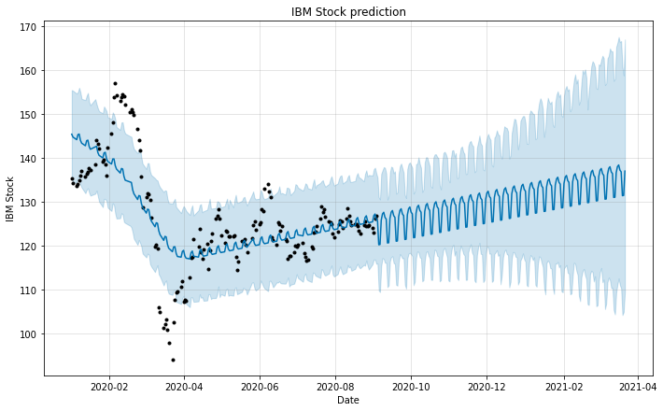
IBM STOCKS: Prophet
Prophet: 2020 data --> prediction

Slide 45
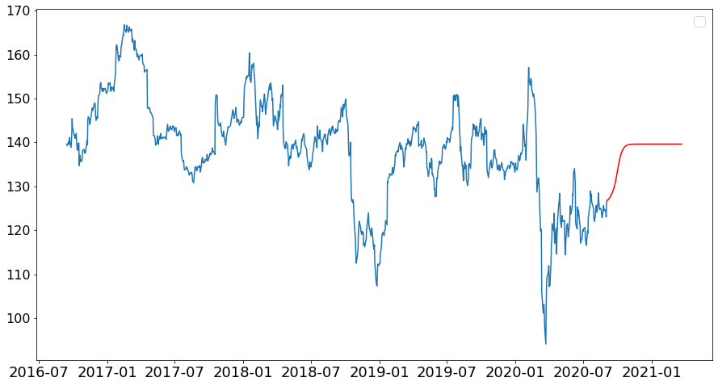
IBM STOCKS: LSTM
LSTM (Deep Learning) 1000 days --> prediction

Slide 46
IBM STOCKS: LSTM
LSTM (Deep Learning) 2020 data--> prediction

Slide 47
IBM STOCKS: SARIMA
SARIMA 1000 days--> validation

Slide 48
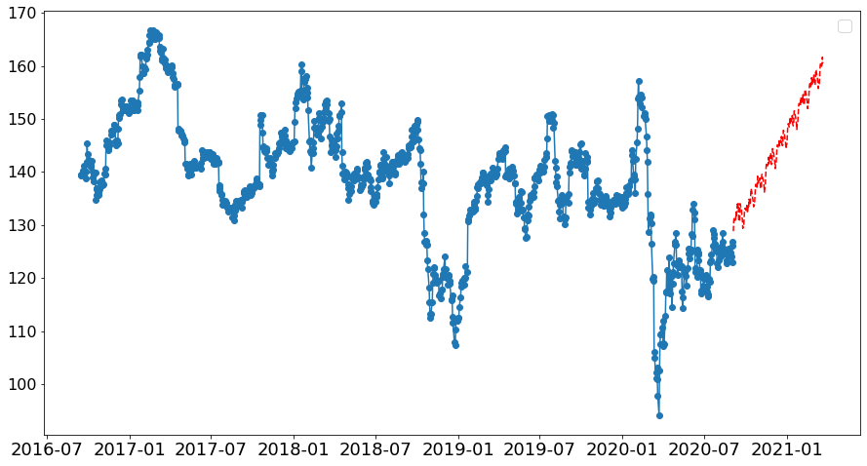
IBM STOCKS: SARIMA
SARIMA 1000 days--> prediction

Slide 49
IBM STOCKS: SARIMA
SARIMA 1000 days--> prediction

Slide 50
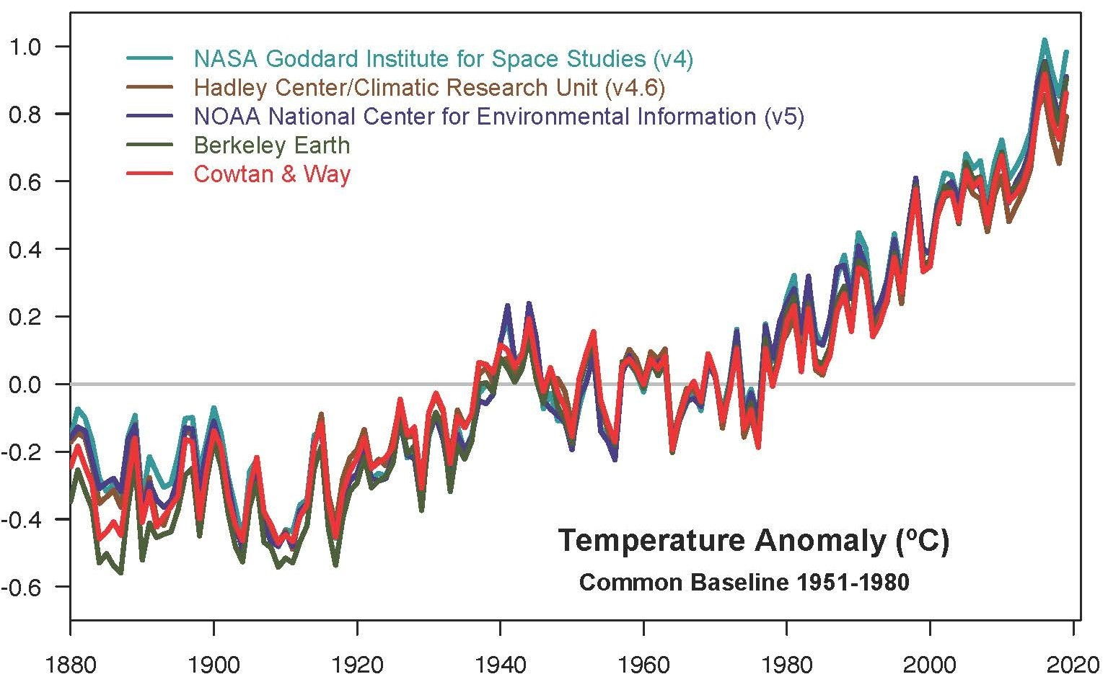
Global WARMING?

Slide 51
CSP Team?

Slide 52
Github COde
https://github.com/dongzhang84/time_series_analysis/blob/master/time_series_case_study.ipynb

Slide 53
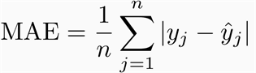
quality metrics
R squared
Mean Absolute Error (MAE)
Median Absolute Error (MAE)
Mean Squared Error (MSE)
Mean Squared Logarithmic Error (MSLE)
Mean Absolute Percentage Error (MAPE)

Slide 54
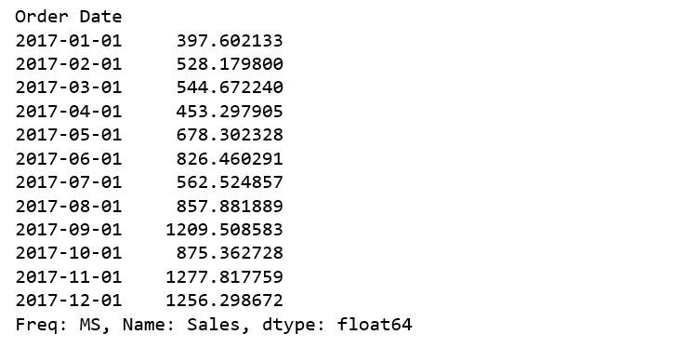
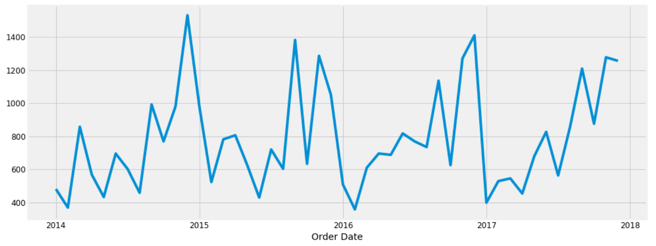
Third Example
Furniture Sales as a Time Series
https://towardsdatascience.com/an-end-to-end-project-on-time-series-analysis-and-forecasting-with-python

Slide 55
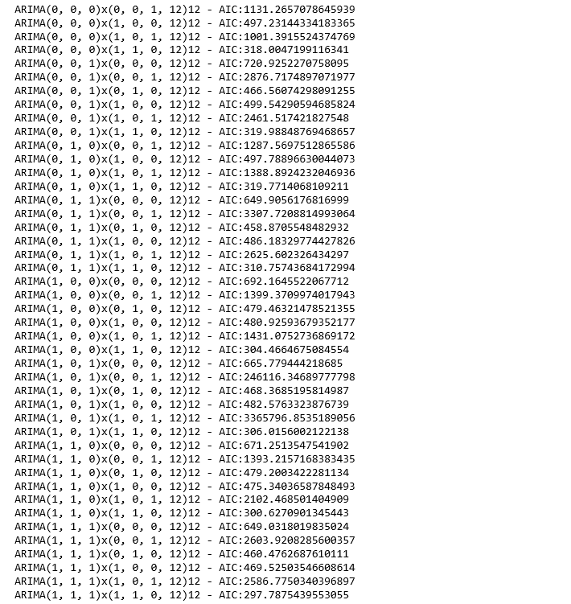
Sales as a Time Series
(SARIMA) --> (p,d,q)(P,D,Q,s)
https://towardsdatascience.com/an-end-to-end-project-on-time-series-analysis-and-forecasting-with-python-4835e6bf050b
AIC: Akaike Information Criterion
SARIMA:(1, 1, 1)x(1, 1, 0, 12)

Slide 56
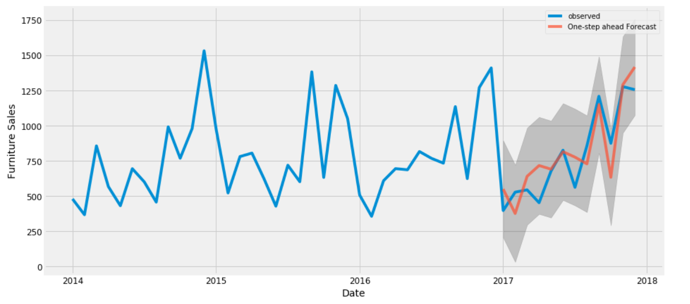
Sales as a Time Series
(SARIMA) --> (p,d,q)(P,D,Q,s)
https://towardsdatascience.com/an-end-to-end-project-on-time-series-analysis-and-forecasting-with-python-4835e6bf050b
AIC: Akaike Information Criterion
SARIMA:(1, 1, 1)x(1, 1, 0, 12)

